Slide 1
Effelsberg Tutorial
Fundi Tutorials 2025

Slide 2
Overview
The 100-m telescope (technical specifications)
Before the observation
Selecting targets
Checking visibility
Creating a schedule
Observing with effelsberg
Setting up the observation
Checking observation status
Data reduction
???

Slide 3
The 100-m telescope

Slide 4
Out situation
Thou art blessed with free observation time
Alex has granted you 2 hours on the telescope. You can observe anything you like with any receiver you want to.
I’ll help you to:
Decide what to observe
Prepare for observation
Run your observation
https://www.mpifr-bonn.mpg.de/person/27688

Slide 5
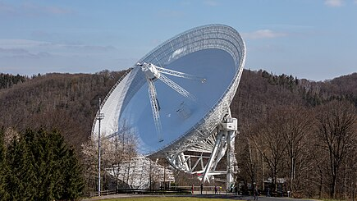
Effelsberg
Start of operations: 1972
Dish diameter: 100 m
Aperture: 7.854 m²
Panels: 2.352
Surface accuracy: < 0.5 mm
Weight: 3.200 tonnes
Operational frequencies: 0.3-96 GHz
Slew speed: 16º/min (tilt) 30º/min (rotation)
Pointing accuracy: 10’’

Slide 6
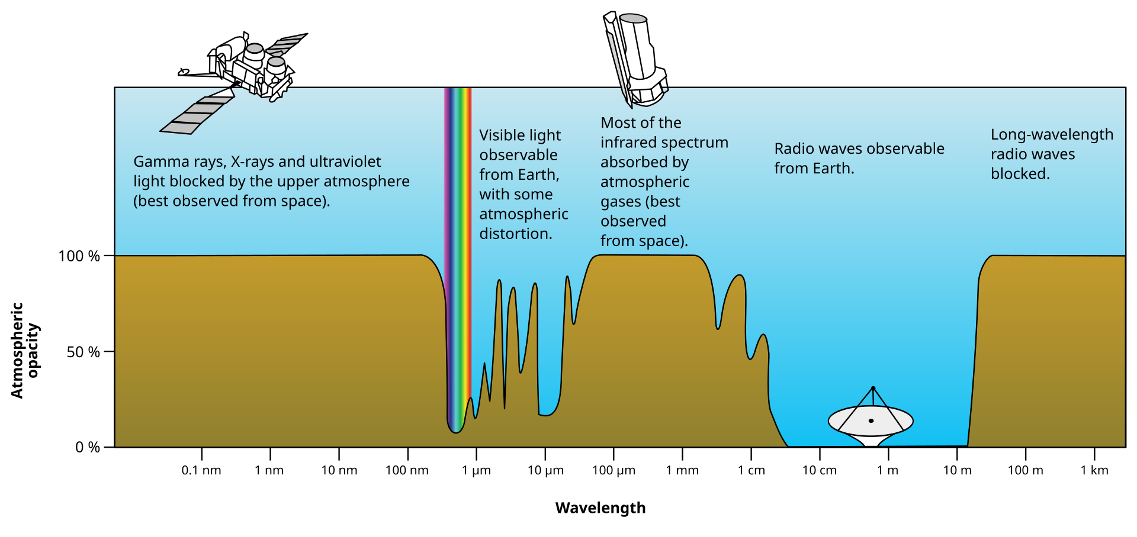
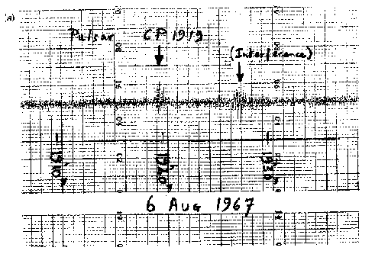
The fundamentals of a radio-telescope
A radio telescope detects free EM radiation in the radio regime; turns them into an electrical signal, which is then amplified, processed and finally saved in some form. (check out Mary's lecture on Thursday “How radio telescopes work”)

Slide 7
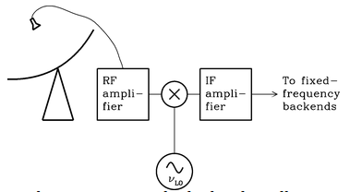
From EM wave to a file
Frontend
IF system
Backend
Dish - Focuses EM waves
Receiver - Converts free EM into AC current
Amplifier - Amplifies the current (LNA)
Mix signal down to baseband
Filter unwanted frequencies
Turn analogue signal into digital
Process digital signal
Store digital signal
Ransom & Condon, fig 3.39

Slide 8
Why do I care?
To successfully observe a source, you need to understand what your telescope is capable of
Sensitivity vs. source flux
Gain
Beam size vs. source size
Confusion limits
Emission bandwidth vs. receiver bandwidth
System noise (noise limits)
Time resolution

Slide 9
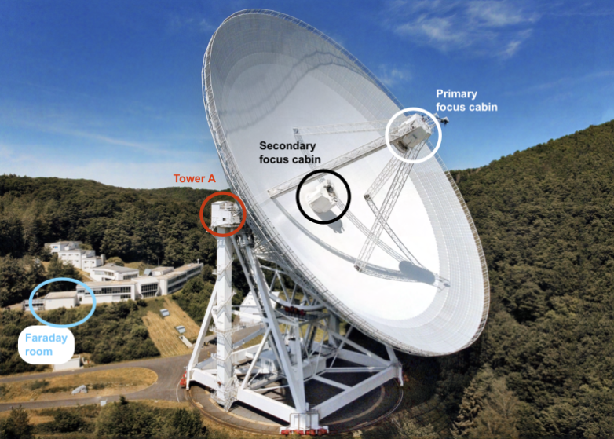
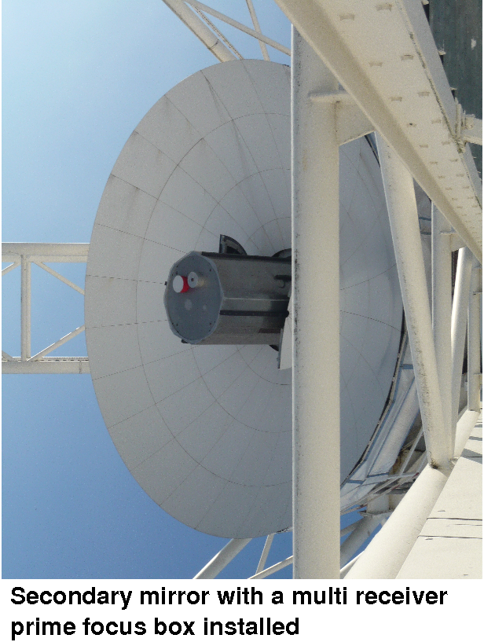
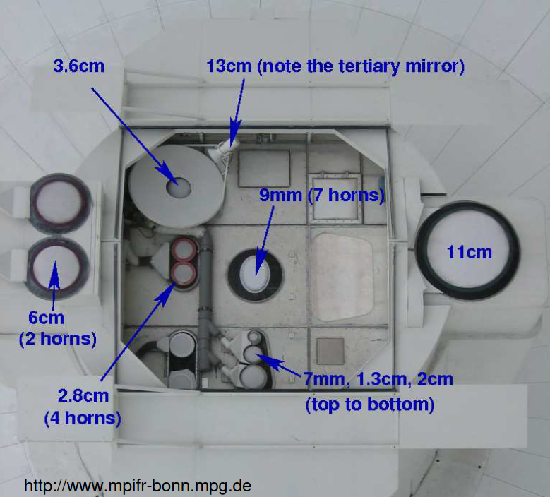
Effelsberg Receivers
Primary focus
Secondary focus

Slide 10
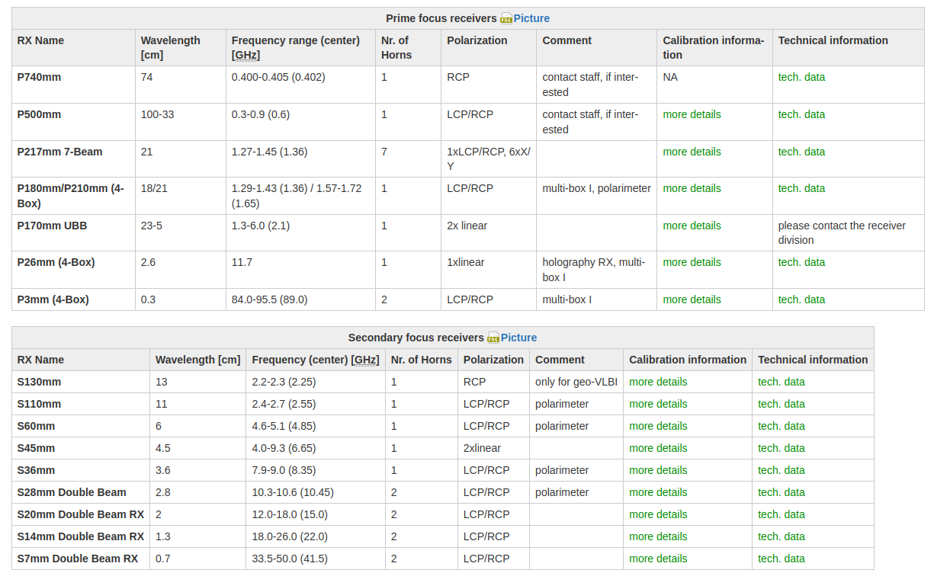

Slide 11
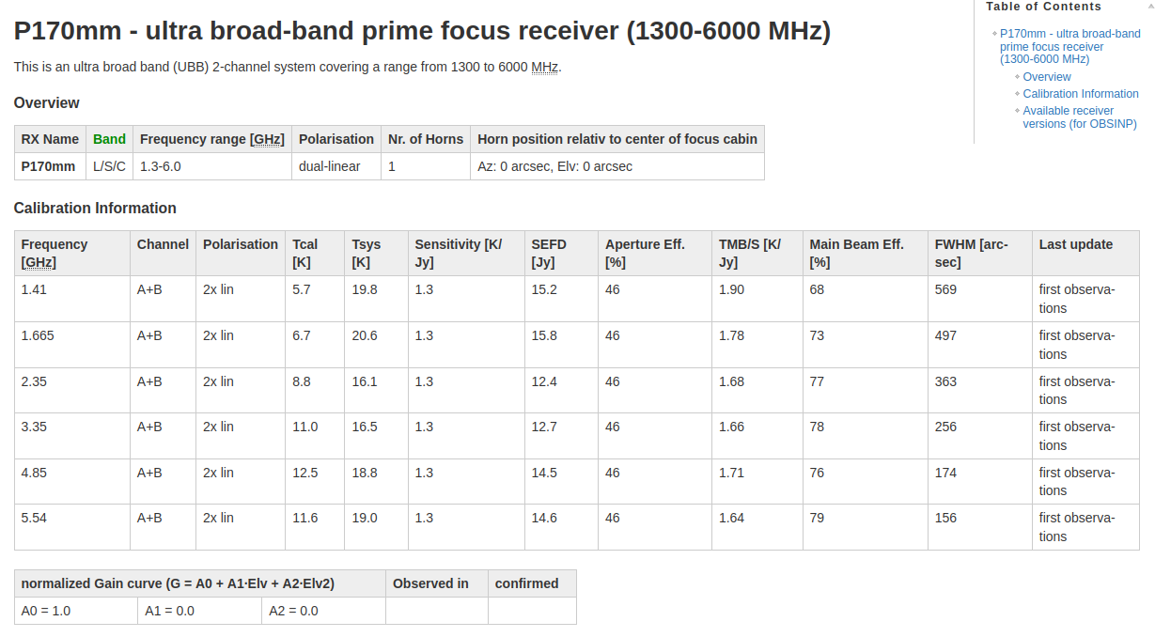

Slide 12
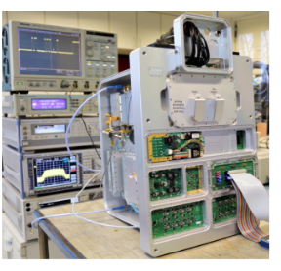
EDD
Dish - Focuses EM waves
Receiver - Converts free EM into AC current
Amplifier - Amplifies the current (LNA)
Mix signal down to baseband
Filter unwanted frequencies
Turn analogue signal into digital
Process digital signal
Store digital signal
Effelsberg Direct Digitization
An IF system and backend in one
Handles all receivers
Digitizes data directly after amplification
Handles multiple observation modes simultaneously

Slide 13
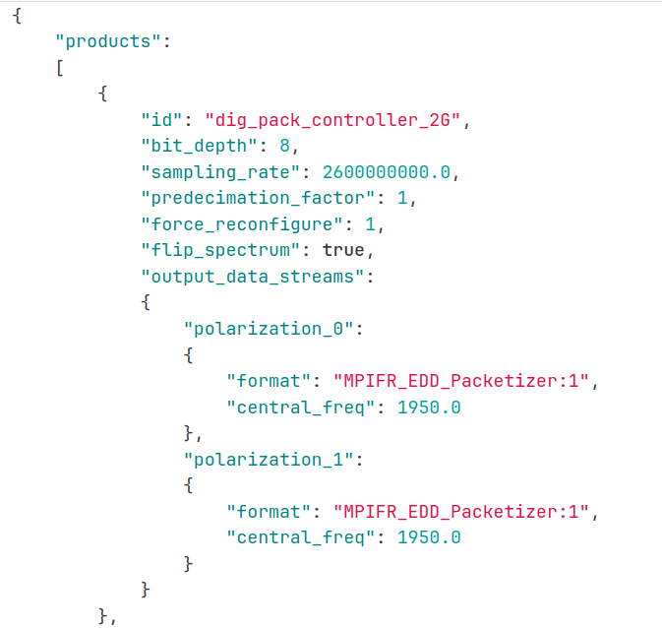
EDD - What does it mean for you?
One system for every case
It’s where you control the way that the raw data is handled:
Time resolution
Channel size
Polarization
Calibration (turn pol-cal diode on and off)
Zap-channels
Etc.

Slide 14
EDD how do I know what to use?
Not easy to know. Ask someone who has made the kind of observations.
Alternatively check this repository: https://gitlab.mpcdf.mpg.de/mpifr-bdg/edd_provisioning_effelsberg
Each data reduction pipeline has a provision that dictates how the data gets processed. Different pipelines give you completely different data products:
P170_PULSAR_SEARCH = filterbanks
P170_PULSAR_TIMING = folded PSRFITS archives

Slide 15
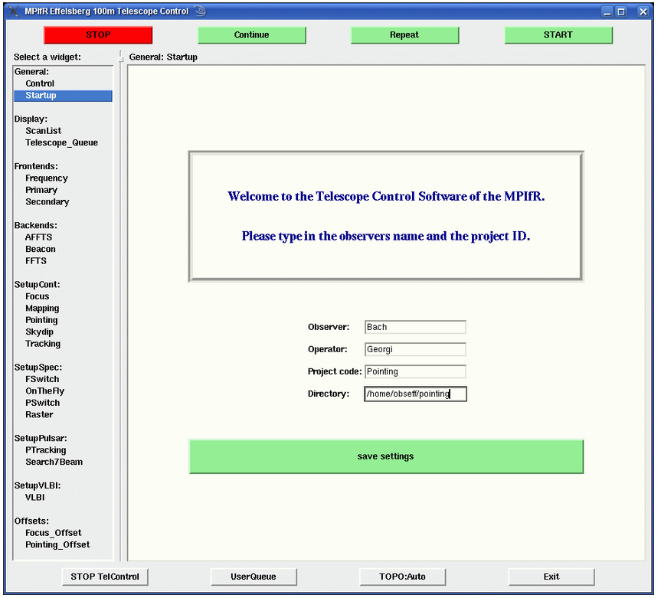
OBSNIP
User interface (frontend)
Select targets
Select receivers
Select backend (kind of)
Check pointing and focusing
Start/Stop observations
https://eff100mwiki.mpifr-bonn.mpg.de/doku.php?id=information_for_astronomers:user_guide:obsinp

Slide 16
Final note
Check out the Effelsberg wiki. It has most of the technical information that you would need https://eff100mwiki.mpifr-bonn.mpg.de/doku.php?id=start
Need professional help? - Ramesh
Problems with EDD? - Jason Wu
Issues with pyriseset3/coastguard3? - Me
Other observers: Marlon, Pranav, Fazal, Kristen, …

Slide 17
2. Before the observation

Slide 18
During this part, we will be creating a schedule that can be used to tell Effelsberg what to observe.
You can find the schedule (and some other stuff) here:
‘/homes/jjawor/FUNDI_tutorials’

Slide 19
Pulsar timing observations
Observation details:
Date: 2025-02-10
UTC start: 13.30
UTC end: 16.30
Source: B2021+51
RAJ 20:22:49.8730"
DEC +51:54:50.233
Select pulsar that we want to time: B2021+51
Is it visible?
Can Effelsberg detect it?
De we need polarization information?
Do we need flux calibration?
Do we have the ephemeris (folding only)

Slide 20
We have decided to use the UBB (P170) receiver and the P170_PULSAR TIMING pipe from EDD (This pipeline will fold out data, producing PSRFITS archives)
“””
FE:P170mm ; EDD_PULSAR_TIMING ; Init 1
“””

Slide 21
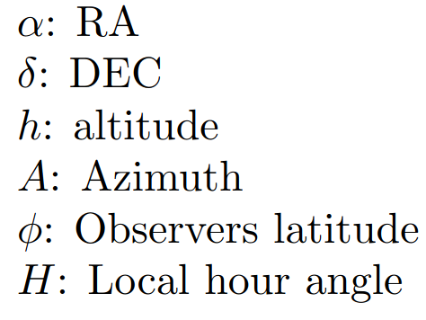
Is it visible?

Slide 22
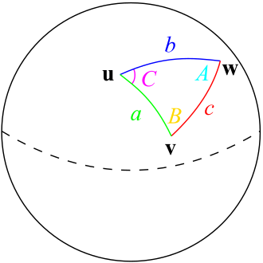
https://auass.com/wp-content/uploads/2021/01/Astronomical-Algorithms.pdf

Slide 23
Is it visible? - Computerized help
Computers exist, so you can have some help from those if you don’t feel like doing math:
Astropy
Pyriseset(3) https://gitlab1.mpifr-bonn.mpg.de/jjawor/pyriseset3/-/tree/main/pyriseset3?ref_type=heads
Schedules
Can create EDD-ready schedules
Visibility tracks
Current position of sources

Slide 24
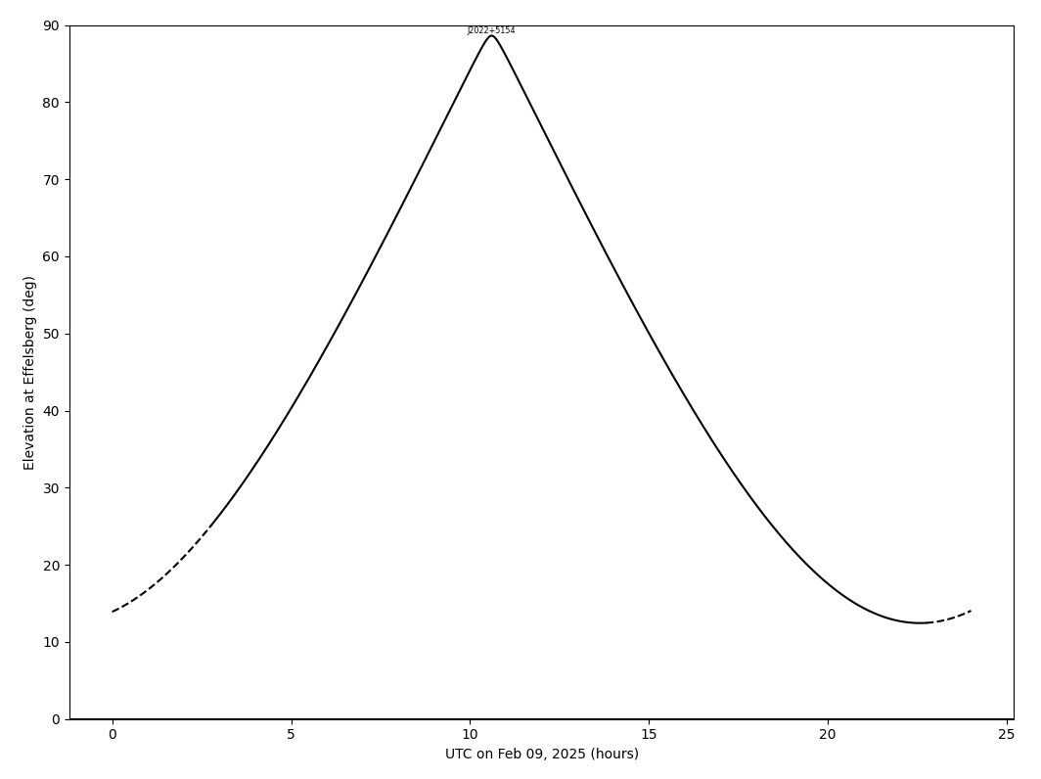
Under horizon!

Slide 25
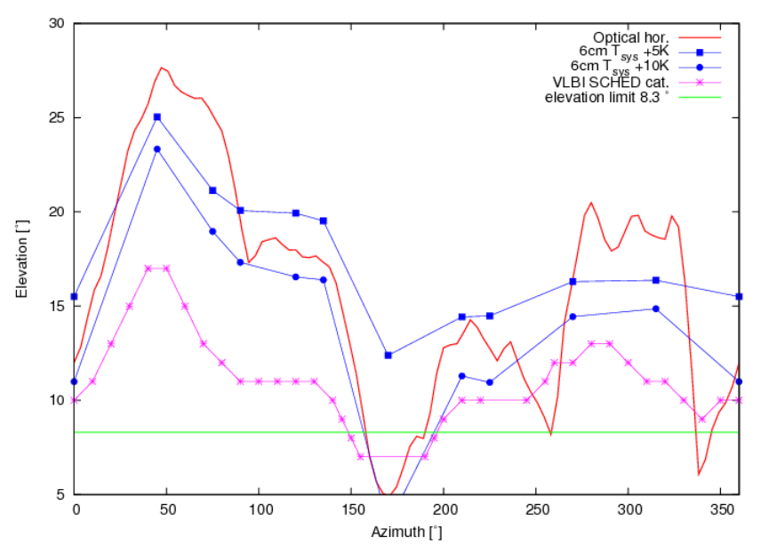

Slide 26
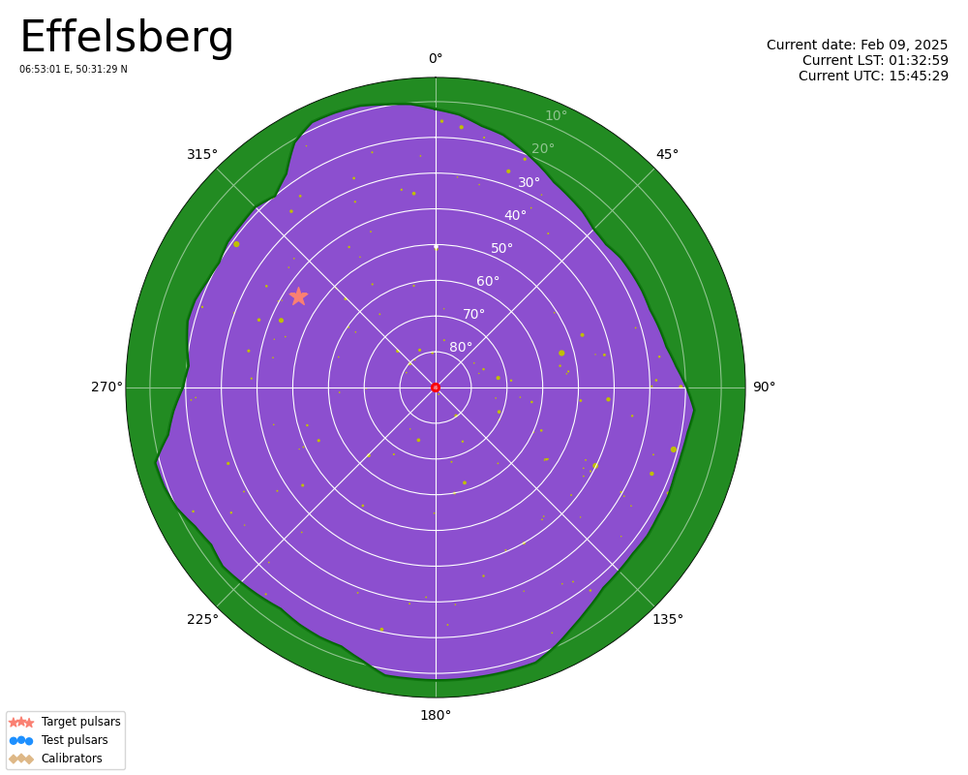

Slide 27
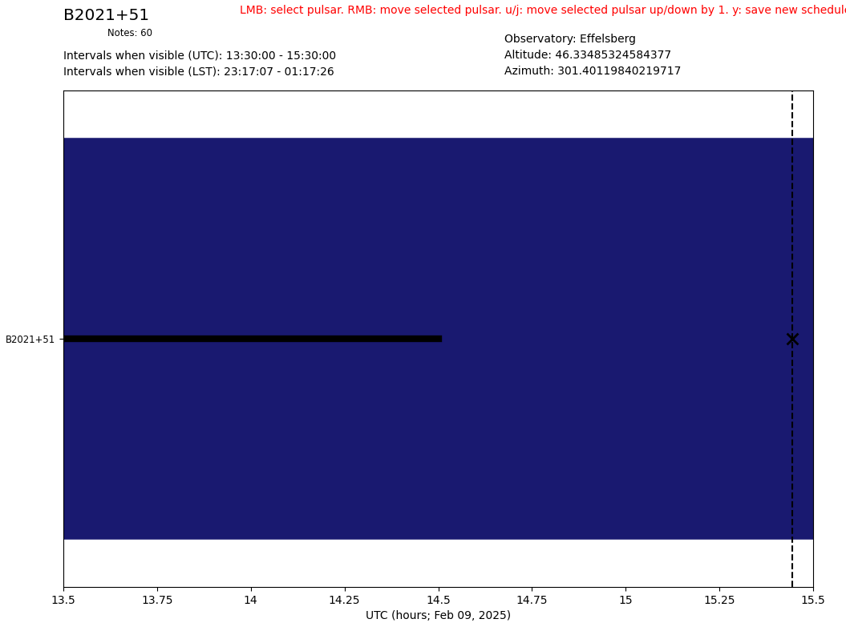
Is it visible? - The schedule
Create a .txt schedule file with this formatting: # Name RA DEC – Observation length B2021+51 20:22:49 51:54:50 -- 60
Name it anything (schedule.txt)
Run the following command

Slide 28
Is it visible? - The schedule
The .txt schedule is not compatible with OBSNIP and EDD. We need to write a .sch file like this (schedule.sch):
“”” SENDTO EDD JSON MEASUREMENTPREPARE {"dig_pack_controller_2G":{"noise_diode_pattern":{"percentage":"0.0","period":"1.0"}}}
B2021+51 ; CoordinateSystem Equatorial ; Equinox J2000 ; ObjectLongitude 20h 22m 50.00s ; ObjectLatitude +51d 54' 50.00" ; LatOff 0.0 ; LonOff 0.0 ; PMODE Search ; SCANTime 180 “”” Pyriseset3 can automatically convert between the .txt and .sch schedules

Slide 29
Is it visible? - The schedule
“””
FE:P170mm ; EDD_PULSAR_TIMING ; Init 1
SENDTO EDD JSON MEASUREMENTPREPARE {"dig_pack_controller_2G":{"noise_diode_pattern":{"percentage":"0.0","period":"1.0"}}}
B2021+51 ; CoordinateSystem Equatorial ; Equinox J2000 ; ObjectLongitude 20h 22m 50.00s ; ObjectLatitude +51d 54' 50.00" ; LatOff 0.0 ; LonOff 0.0 ; PMODE Search ; SCANTime 180 “””

Slide 30
Is it visible? - do I need a schedule?
No. It is possible to manually select targets

Slide 31
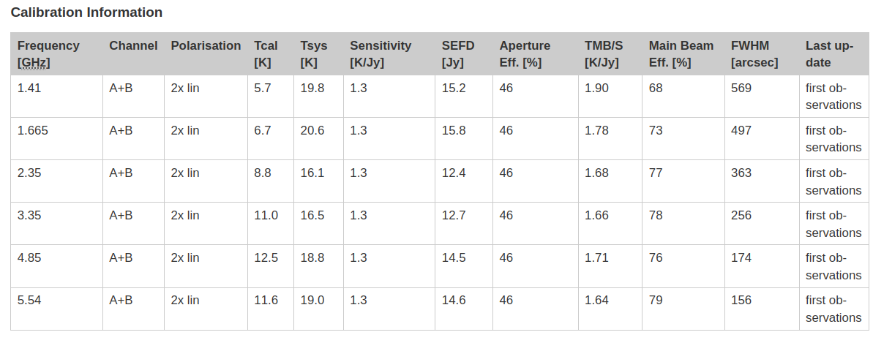
Can Effelsberg detect it?
You can check the system equivalent flux density (SEFD) on the effelsberg wiki SEFD: The flux density of a radio source that doubles the system temperature

Slide 32
Can Effelsberg detect it? - B2021+51
α: SNR, β: Digitization and processing losses (assume 1), n_{p}: no. of polarization channels, t_{i}: integration time, P: pulse period, W: Pulse profile width, G: Gain, △f: frequency bandwidth, T_{sys}: system temperature

Slide 33
Can Effelsberg detect it? - B2021+51
t_{i} = 300s, △f=650MHz
SNR = 8.5

Slide 34
Do we need polarization calibration?
Two options:
Polarization calibration diode
Source with known polarization
Remember to check if the polarization channel basis on the wiki!
If you want polarization calibration you have to add it to the schedule!

Slide 35
Do we need polarization calibration? - The Schedule
“””
FE:P170mm ; EDD_PULSAR_TIMING ; Init 1
SENDTO EDD JSON MEASUREMENTPREPARE {"dig_pack_controller_2G":{"noise_diode_pattern":{"percentage":"0.5","period":"1.0"}}}
B2021+51_R ; CoordinateSystem Equatorial ; Equinox J2000 ; ObjectLongitude 20h 22m 50.00s ; ObjectLatitude +51d 54' 50.00" ; LatOff 0.5 ; LonOff 0.0 ; PMODE CalFE ; SCANTime 120
SENDTO EDD JSON MEASUREMENTPREPARE {"dig_pack_controller_2G":{"noise_diode_pattern":{"percentage":"0.0","period":"1.0"}}}
B2021+51 ; CoordinateSystem Equatorial ; Equinox J2000 ; ObjectLongitude 20h 22m 50.00s ; ObjectLatitude +51d 54' 50.00" ; LatOff 0.0 ; LonOff 0.0 ; PMODE Search ; SCANTime 180 “””

Slide 36
Do we need flux calibration?
If yes. You need to include a source with a known (and stable…) flux. AGNs are the usual choices.
Keep in mind that proper calibration is non-trivial:
Atmospheric opacity
Antenna gain
Antenna effective area
Elevation gain changes
…

Slide 37
Do we need flux calibration? - In practice
Do PFP (pointing-focus-pointing) from time to time and at the start of observation!
Observe a regular calibration source (point-like, high flux density, stable), ideally over a large range of elevations
Measure or estimate atmospheric opacity
https://www.mpifr-bonn.mpg.de/948117/Bach_Calibration_ESSEA2010.pdf

Slide 38
Do we need flux calibration?
Check:
https://www.mpifr-bonn.mpg.de/948117/Bach_Calibration_ESSEA2010.pdf
J.W.M Baars, et al., 1977, A&A 61, 99
J.D. Kraus: “Radio Astronomy”, 1986, Cygnus-Quasar-Books, Powel OH
K. Roholfs & T.L. Wilson: “Tools of Radio Astronomy”, 1996, Springer-Verlag, Berlin
J.W.M Baars: “The paraboloidal reflector antenna in radio astronomy and communication: theory and practice”, 2007, Springer, New York

Slide 39
Do we need polarization calibration? - The Schedule
Let’s add a known flux density source, the AGN 3C286.
“””
SENDTO EDD JSON MEASUREMENTPREPARE {"dig_pack_controller_2G":{"noise_diode_pattern":{"percentage":"0.5","period":"1.0"}}}
3C286_N_R ; CoordinateSystem Equatorial ; Equinox J2000 ; ObjectLongitude 13h 31m 08.00s ; ObjectLatitude +30d 30' 33.00" ; LatOff 1.0 ; LonOff 0.0 ; PMODE CalFE ; SCANTime 12
SENDTO EDD JSON MEASUREMENTPREPARE {"dig_pack_controller_2G":{"noise_diode_pattern":{"percentage":"0.5","period":"1.0"}}}
3C286_O_R ; CoordinateSystem Equatorial ; Equinox J2000 ; ObjectLongitude 13h 31m 08.00s ; ObjectLatitude +30d 30' 33.00" ; LatOff 0.0 ; LonOff 0.0 ; PMODE CalFE ; SCANTime 120
SENDTO EDD JSON MEASUREMENTPREPARE {"dig_pack_controller_2G":{"noise_diode_pattern":{"percentage":"0.5","period":"1.0"}}}
3C286_S_R ; CoordinateSystem Equatorial ; Equinox J2000 ; ObjectLongitude 13h 31m 08.00s ; ObjectLatitude +30d 30' 33.00" ; LatOff -1.0 ; LonOff 0.0 ; PMODE CalFE ; SCANTime 120

Slide 40
Do we need polarization calibration? - The Schedule
“””
FE:P170mm ; EDD_PULSAR_TIMING ; Init 1
SENDTO EDD JSON MEASUREMENTPREPARE {"dig_pack_controller_2G":{"noise_diode_pattern":{"percentage":"0.5","period":"1.0"}}}
3C286_N_R ; CoordinateSystem Equatorial ; Equinox J2000 ; ObjectLongitude 13h 31m 08.00s ; ObjectLatitude +30d 30' 33.00" ; LatOff 1.0 ; LonOff 0.0 ; PMODE CalFE ; SCANTime 120
SENDTO EDD JSON MEASUREMENTPREPARE {"dig_pack_controller_2G":{"noise_diode_pattern":{"percentage":"0.5","period":"1.0"}}}
3C286_O_R ; CoordinateSystem Equatorial ; Equinox J2000 ; ObjectLongitude 13h 31m 08.00s ; ObjectLatitude +30d 30' 33.00" ; LatOff 0.0 ; LonOff 0.0 ; PMODE CalFE ; SCANTime 120
SENDTO EDD JSON MEASUREMENTPREPARE {"dig_pack_controller_2G":{"noise_diode_pattern":{"percentage":"0.5","period":"1.0"}}}
3C286_S_R ; CoordinateSystem Equatorial ; Equinox J2000 ; ObjectLongitude 13h 31m 08.00s ; ObjectLatitude +30d 30' 33.00" ; LatOff -1.0 ; LonOff 0.0 ; PMODE CalFE ; SCANTime 120
SENDTO EDD JSON MEASUREMENTPREPARE {"dig_pack_controller_2G":{"noise_diode_pattern":{"percentage":"0.5","period":"1.0"}}}
B2021+51_R ; CoordinateSystem Equatorial ; Equinox J2000 ; ObjectLongitude 20h 22m 50.00s ; ObjectLatitude +51d 54' 50.00" ; LatOff 0.5 ; LonOff 0.0 ; PMODE CalFE ; SCANTime 120
SENDTO EDD JSON MEASUREMENTPREPARE {"dig_pack_controller_2G":{"noise_diode_pattern":{"percentage":"0.0","period":"1.0"}}}
B2021+51 ; CoordinateSystem Equatorial ; Equinox J2000 ; ObjectLongitude 20h 22m 50.00s ; ObjectLatitude +51d 54' 50.00" ; LatOff 0.0 ; LonOff 0.0 ; PMODE Search ; SCANTime 180 “””

Slide 41
Do we have the correct ephemeris?
Pulsar timing only!
If the ephemeris is wrong. The pulse in the folded archives will drift.
If you wish to update it, contact Jason.

Slide 42
3. Observing with Effelsberg

Slide 43
Steps for observing session
join `Mattermost for observing’: Eff100mObs (https://mattermost.mpifr-bonn.mpg.de/eff100mobs/channels/current-observations)
on your day of observations, message eff_operator on Mattermost
Introduce yourself ~30 min before observing, and say which project you will be observing for and when
ask for obseff password (so you can scp your schedule to obseff@observer8:/home/obseff/pulsar/Scripts/)
or, if you have access to paf0, you can ssh from pulsar@paf0 (w.o. obseff password)
ask eff_operator for vpn password (so you can access the interface/frontend)
do not login to interface yet, because someone else may be observing
Note you can tell the operator your schedule name and ask them to load your schedule and start observations for you.
Usually, one wants to login to the interface themselves, so they can rearrange the sources in the observing queue if necessary. Sometimes weather (or other problems) causes delays and you need to adjust your schedule on-the-fly!

Slide 44
Load your schedule
scp <your schedule> obseff@observer8:/home/obseff/pulsar/Scripts/
The operator will give the password to you if you ask nicely
Check if your schedule is loaded. Also can peruse other schedules.
ssh obseff@observer8
cd /home/obseff/pulsar/Scripts/
ls <your schedule>

Slide 45
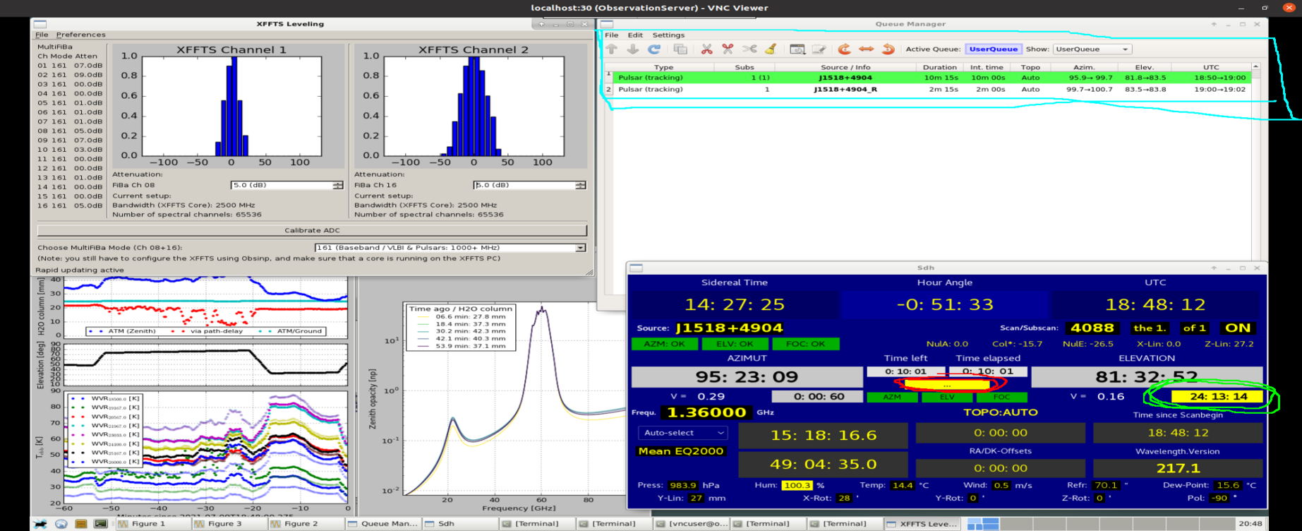
Access interface (for loading schedule; start/stop observations; adjust observing queue)*
I use Turbo VNC (can also use VNC viewer) to access the observing interface
For the ssh connections below, substitute your username, and you will use your portal password when prompted
DO NOT use VNC password provided by Effelsberg operator here! if you enter the wrong password too many times, you will be locked out for 30 min.
The main screens:
ssh -X -f -N -L 5931:observer8:5931 username@portal.mpifr-bonn.mpg.de
ssh -X -f -N -L 5921:observer8:5921 username@portal.mpifr-bonn.mpg.de
*again, the operator can load schedule for you, and start your session

Slide 46
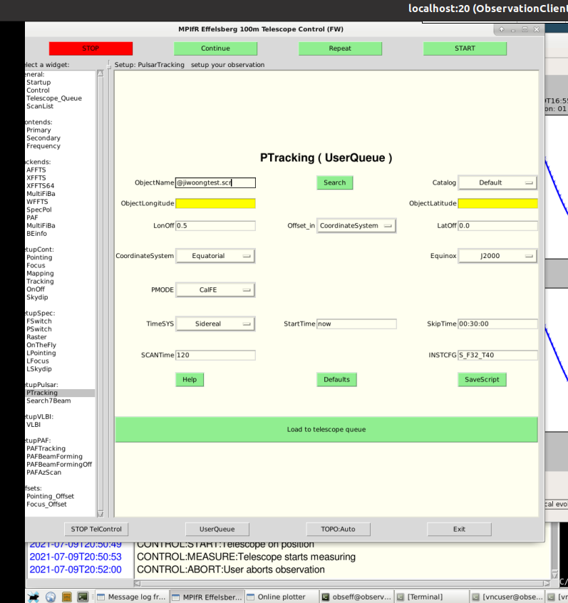
Access interface (for loading schedule; start/stop observations; adjust observing queue)*
I use Turbo VNC (can also use VNC viewer) to access the observing interface
For the ssh connections below, substitute your username, and you will use your portal password when prompted
DO NOT use VNC password provided by Effelsberg operator here! if you enter the wrong password too many times, you will be locked out for 30 min.
The main screens:
ssh -X -f -N -L 5931:observer8:5931 username@portal.mpifr-bonn.mpg.de
ssh -X -f -N -L 5921:observer8:5921 username@portal.mpifr-bonn.mpg.de
*again, the operator can load schedule for you, and start your session

Slide 47
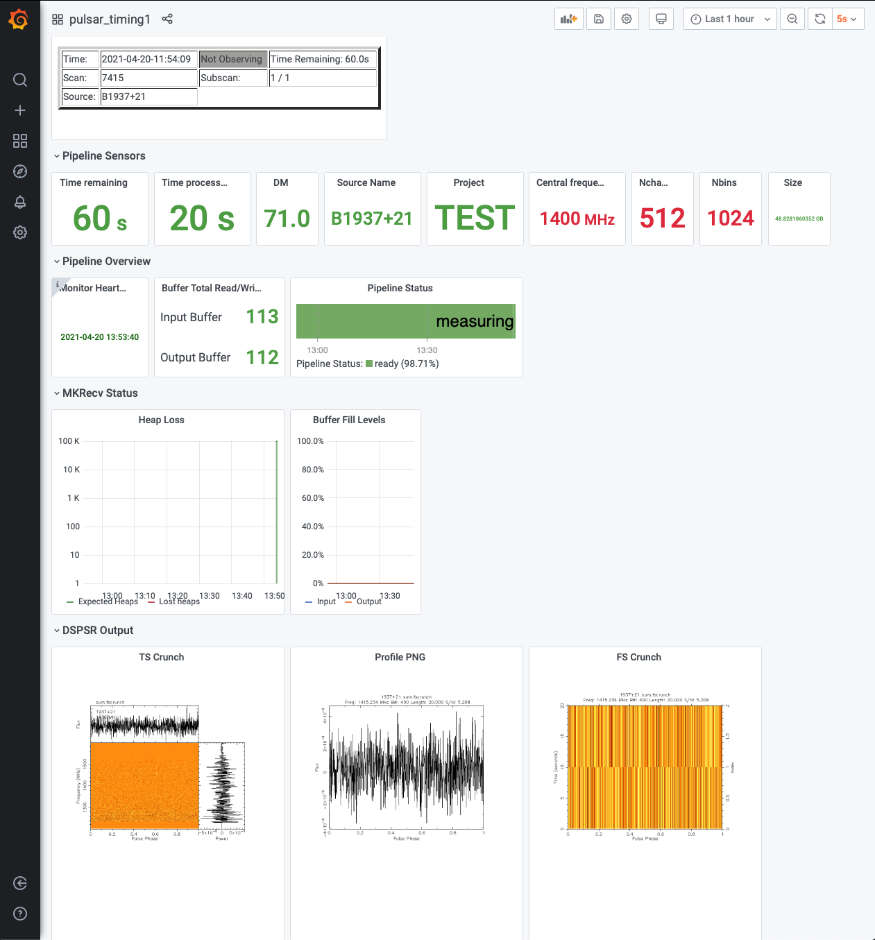
Useful links
disk quota for data product can be check here, for example baseband product
View current schedules: https://eff100mwiki.mpifr-bonn.mpg.de/doku.php?id=schedules
Access the EDD Dashboard (must setup proxy server access with Firefox): http://134.104.74.49:3000/
OR
In the terminal:
ssh -L 3000:eddinfra0:3000 <username>@portal.mpifr-bonn.mpg.de
Web browser link:
http://localhost:3000/?orgId=1&refresh=5s

Slide 48
4. Data Reduction

Slide 49
Where is my data?
Raw data files: ‘/beegfsEDD/EDD_pipeline_data/production/pipeline_data/’
Visible from the eddinfra1 machine (you need access from Uwe Bach)
Some data is automatically transferred to MPIfR servers.
E.g. pulsar timing: ‘/fpra/comiss/01/EDD_STAGING_AREA’

Slide 50
Exercises
Go to: ‘/homes/jjawor/FUNDI_tutorial’ There, you will find a bunch of schedules and some software `singularity shell -B /fpra -B /homes singularity/pipeline_cg3` `pip install software/pyriseset3`
Go to the ATNF catalogue: https://www.atnf.csiro.au/research/pulsar/psrcat/ Pick a couple of pulsars that you want to observe
Using pyriseset3 or astropy, check if your pulsars are on the sky
Make sure that your pulsars have a flux density high enough to be seen by Effelsberg
Create a schedule for your pulsars
Include a flux-calibrator source and polcal-diode observations

Slide 51
Observation details
UTC-start = 15.30.00
UTC-end = 16.00.00
Date = 2025/02/13
Receiver = P170 (UBB) - https://eff100mwiki.mpifr-bonn.mpg.de/doku.php?id=information_for_astronomers:rx_list
Effelsberg location - https://eff100mwiki.mpifr-bonn.mpg.de/doku.php?id=information_for_astronomers:user_guide:antenna

Slide 52
5. Links

Slide 53
Links
General information:
Effelsberg wiki - https://eff100mwiki.mpifr-bonn.mpg.de/doku.php?id=start
Observation Channel - https://mattermost.mpifr-bonn.mpg.de/eff100mobs/channels/town-square
Theory:
J.D. Kraus: “Radio Astronomy”, 1986, Cygnus-Quasar-Books, Powel OH
K. Roholfs & T.L. Wilson: “Tools of Radio Astronomy”, 1996, Springer-Verlag, Berlin
J.W.M Baars: “The paraboloidal reflector antenna in radio astronomy and communication: theory and practice”, 2007, Springer, New York

Slide 54
Links
Schedules
EDD repo - https://gitlab.mpcdf.mpg.de/mpifr-bdg/edd_provisioning_effelsberg
pyriseset3 - https://gitlab1.mpifr-bonn.mpg.de/jjawor/pyriseset3
astropy - https://www.astropy.org/
Observation:
VNC software - https://www.realvnc.com/en/connect/download/viewer/
Mattermost channel - https://mattermost.mpifr-bonn.mpg.de/eff100mobs/channels/current-observations
VNC tunnel ports: ssh -X -f -N -L 5931:observer8:5931 username@portal.mpifr-bonn.mpg.de
ssh -X -f -N -L 5921:observer8:5921 username@portal.mpifr-bonn.mpg.de
ssh -L 3000:eddinfra0:3000

Slide 55
Links
Data Reduction
psrchive (timing) - https://psrchive.sourceforge.net/
coastguard3 (timing) -https://gitlab1.mpifr-bonn.mpg.de/jjawor/coastguard3
pulsarx (pulsar searches) - https://github.com/ypmen/PulsarX
transientx (transient searches) - https://github.com/ypmen/TransientX

